Slide 1
Image Reconstruction from multiple OCT Partial Images
by Astrid Florio
Supervisors: Dr Robert Donnan | Dr Pete Tomlins (SMD)

Slide 2
Motivation
Most dental imaging techniques involve ionizing radiation.
Non invasive techniques cannot currently be used to observe tooth decay in-between teeth.
Optical coherence tomography (OCT) is a cost-effective imaging technique.
However, it cannot penetrate the tooth fully and therefore can only image the surface.
OCT is generally considered unsuitable if the area cannot be accessed directly.

Slide 3
Aims and Objectives
Problem Statement
Use partial OCT images to reconstruct a full 3D image of a tooth to observe tooth decay in between teeth
Image Capture
Use a rotating stage, to capture images of sections of teeth at different angles and
Reconstruction
Develop MATLAB code to allow reconstruction of 3D images from a sequence of images at varying angles.

Slide 4
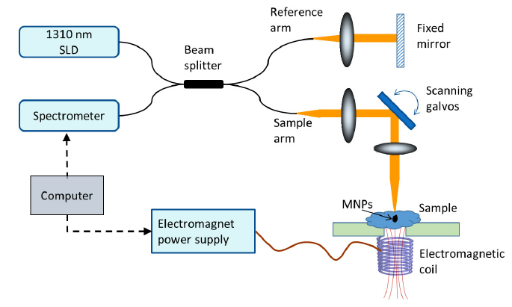
Spectral-Domain OCT

Slide 5
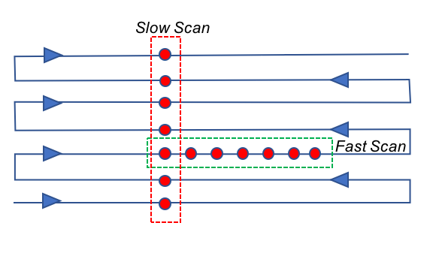
OCT Image Capture
A set of consecutive A-scans where the sample beam is moved across the sample
Multiple A-scans form a B-scan)

Slide 6
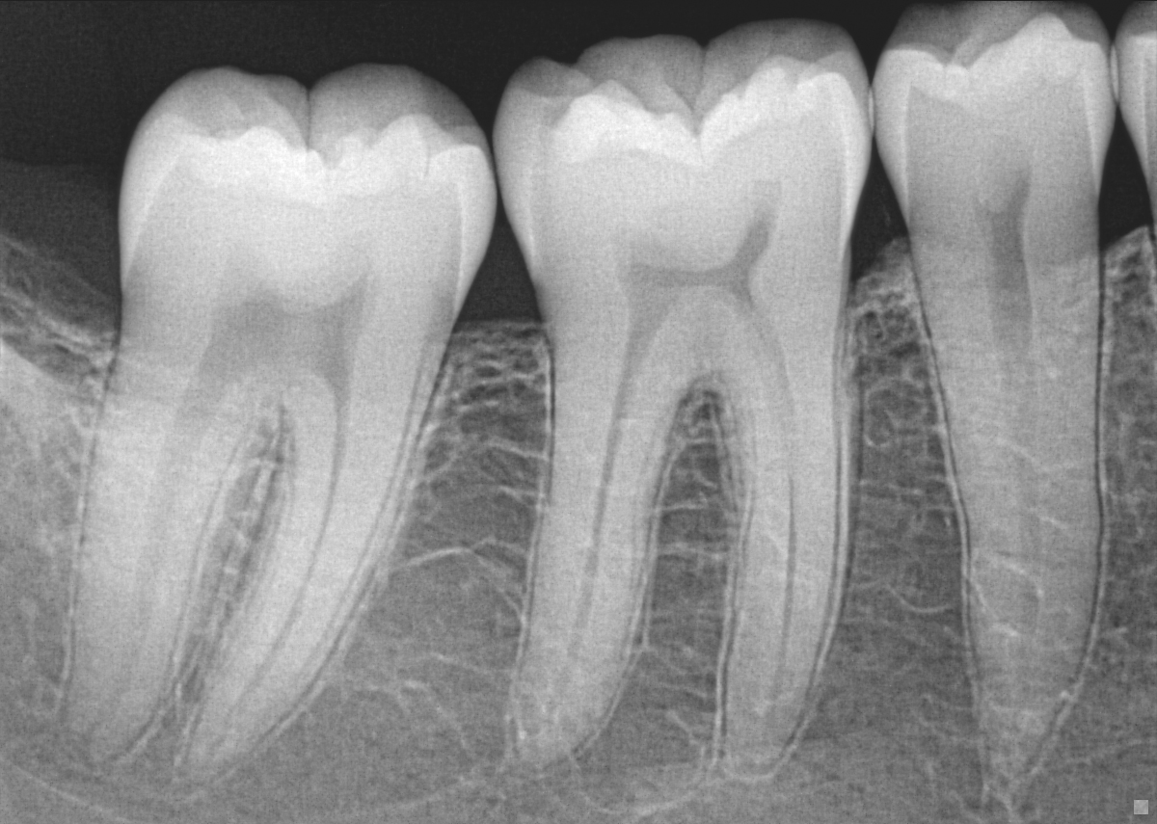
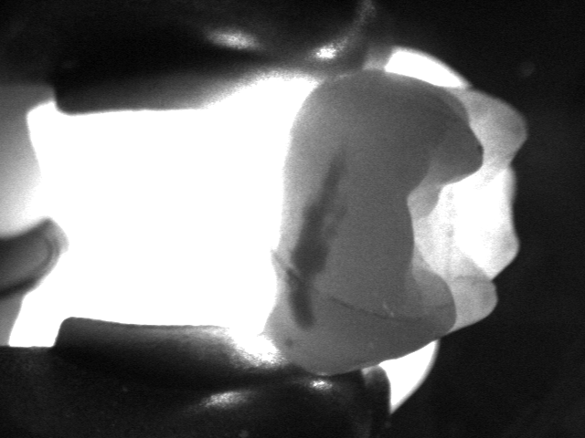
Other Dental imaging techniques
X-Ray
Transillumination

Slide 7
Methodology

Slide 8
Preliminary Images
Some images of the tooth identified captured without the use of the rotating stage but by rotating the tooth manually.
Tooth presents a lesion in the proximal side which would be impossible to image directly using OCT in vivo.
Since the tooth had been moved manually, the images were extremely misaligned

Slide 9
Image Registration
Direct Methods:
Approaches use pixel-to-pixel matching to align images
First an error metric is chosen to compare the images, then an optimization function is used to find a minimum with respect to the error metric adopted
Many alternatives available for both error metric and optimization
Feature-based Methods:
Extract distinctive features to be matched between the images to estimate the geometric transformation
Features to be matched must be identified
An optimization function is used to estimate the geometric transformation required
Feature extraction either manually (control points selection) or by means of a machine learning
Optimization the same as in direct methods

Slide 10
Preliminary Images (2)
Applying the same transformations, then using automatic registration
The only type of registration yielding good results was using ‘translation’ as the only possible
The ‘rigid’ transformation, was only successful when the rotation transformation was performed in the first step.
Other types of transformation were not useful as they allowed the algorithm to reach a minimum cost too easily by misaligning the images.

Slide 11
Captured Images
A theta-stack
360° image of a tooth consisting of a single B-scan taken at every degree interval rotating the tooth around its height (x-axis)
A y-stack
a flat image at a fixed angle with multiple B-scans taken along the width of the tooth (y-axis)

Slide 12
theta-Stack
Read properties from image data
For each angle read B-scan into a volume
For each pixel compute values for interpolation
Compute interpolation along height of tooth
Save reconstructed volume

Slide 13
Theta-stack (2)

Slide 14
Y-Stack
These images were more similar to the preliminary ones
Captured rotating the stage at ±40° from each face
Images have more overlap than preliminary ones
Apply image registration technique
Pre-processing the image was still crucial
Still easy for the algorithm to find a bad minimum cost if allowed to rotate the image freely
Automatic registration was applied to fine-tune the alignment results
i.e. 45, 90, 135 degrees and 225, 270, 315 degrees
Provided a stable reference for the initial alignment

Slide 15
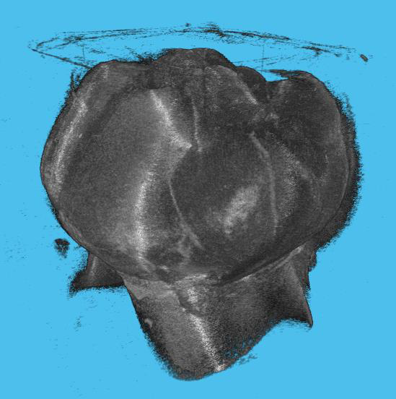
y-stack (2)

Slide 16

Conclusions
Theta-stack
Limited scanned area.
Huge limitation for any clinical application.
Parts not imaged cannot be reconstructed since no information exists.
Y-stack
Better coverage of the tooth surface.
Single image can show most of the proximal side of a tooth (depending on angle, shape and distance between teeth).
Registration
No algorithm could register teeth images without significant pre-processing.
Image registration remains crucial to any clinical applications

Slide 17

Future Works

